Slide 1
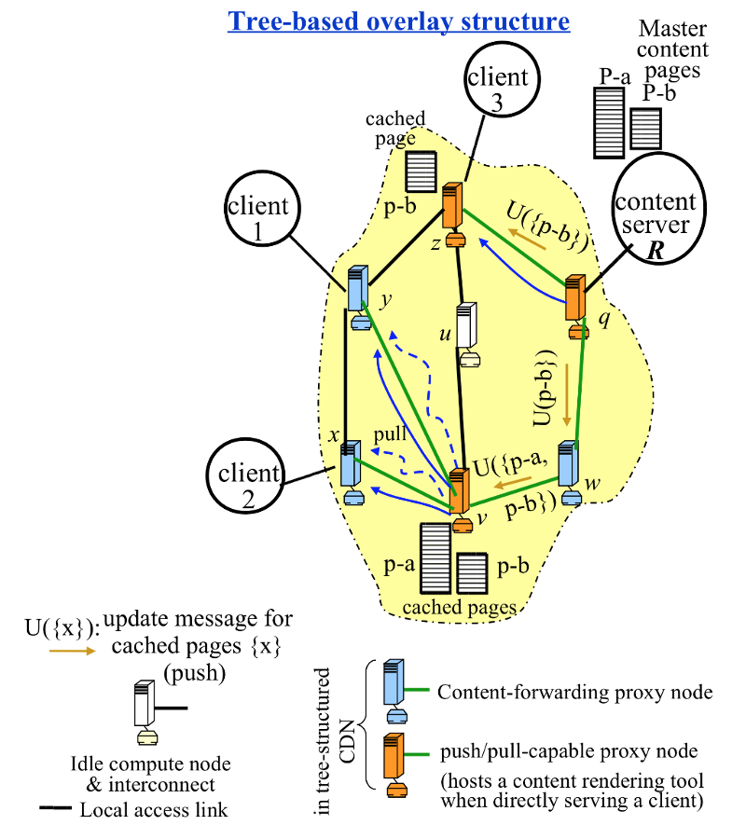
CDN- Content Delivery Network
synchronous network
Client – DRONE
Travel speed 10 meters per second
Communication - talk to neighbor only
WIFI based
160m video communication
200m All Oher Communication
Master Content Pages
P-a - Geographic map
P-b - Pollution based map
U({x})- Function for sending updates of {x}
{x} - cached pages
Z – client 3 Leader Drone
Y – client 1 drone
Z – client 0 drone
Q – Geographic map server U({p-b})
W – Geographic map server U({p-b})
and pollution location U({p-b}, {p-a})
V – Base station – Commanding drones
U – interconnect computer (Drone updates sent)
Leader Drone
Drone
Base Station
Drone
Other Drones n= 2,3,……..
Leader Drone n=1

